Slide 1

International Software projects The Mantid Model
Nick Draper
Tessella
www.mantidproject.org

Slide 2
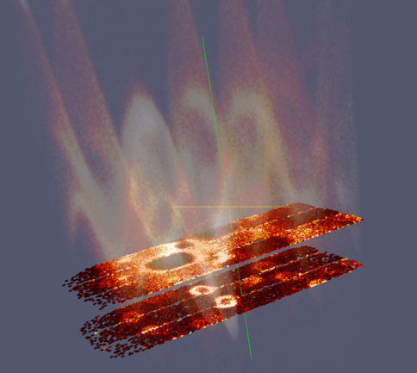
Overview
Mantid Introduction
Current development
A tale of projects past
ISIS-SNS collaboration
How the project works

Slide 3

Project Goals
Goals
Consolidate the data reduction/analysis software for neutron scattering without restricting the needs of the instrument scientists
Key requirement
Create a Data Analysis framework
not instrument or technique/dependent
Cross-platform
Windows, Linux, Mac
Easily extensible
Freely redistributable

Slide 4

Project History
July 2007 Requirements & Design
April 2008 V 1.0 First instrument support
Feb 2010 V1.1 Support multiple techniques
April 2010 Collaboration with SNS & HFIR
Jan 2012 V2.0
Scientist validated results. VATES integration

Slide 5
Design Criteria
Separation of Data and Algorithms
Encapsulated “User Code” in specific places
Algorithms
Workspaces
Use of well designed interfaces to allow generic use of components
Reuse of existing components
Careful memory management when handling large datasets

Slide 6

Architectural Design - Overview
Instrument log files
Python
Command line & Scripting interface
Mantid Framework
RAW data files
API
Algorithms
Workspaces
MantidPlot Graphing and analysis
NEXUS data files
User Defined
User Defined
DAE direct access
Future Instrument specific UI
Future Instrument specific UI

Slide 7
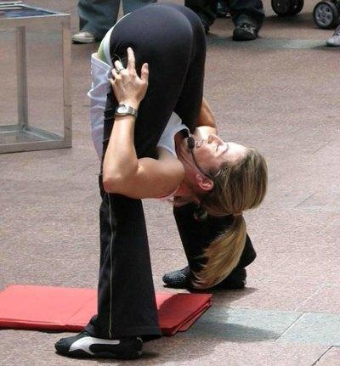
Framework flexibilty
Instrument independence
Virtual instrument defined
Loaded from xml definition
Location, rotation and shape of every pixel
Sample
Source
Technique independence
Algorithms
Unit Reduction and analysis steps
Workflow scripts / Algorithms
Chain algorithms to perform a reduction workflow

Slide 8
Plug in extensions
Algorithm Dialogs Custom Interfaces Custom Menus
Python scripts & libraries
Workflow Algorithms
Algorithms
Unit Conversions
Fit Functions Cost Models Constraints Minimizer
Workspaces
Archive Searching LiveData Listeners Data Catalogs
GUI
Framework
Utility

Slide 9
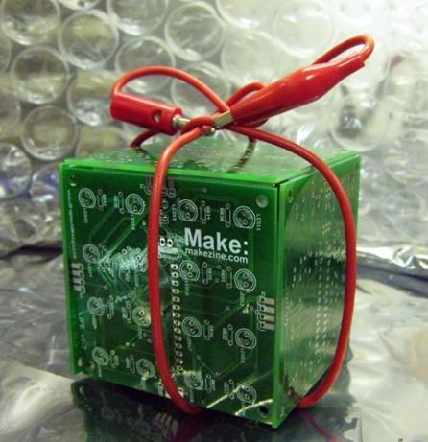
Open Source
GPL v3
Free to use
Source code openly available
Results cannot be sold
Unless you own the copyright
Good basis for collaboration
Sharing benefits to wider community
Why not LGPL, BSD etc?

Slide 10
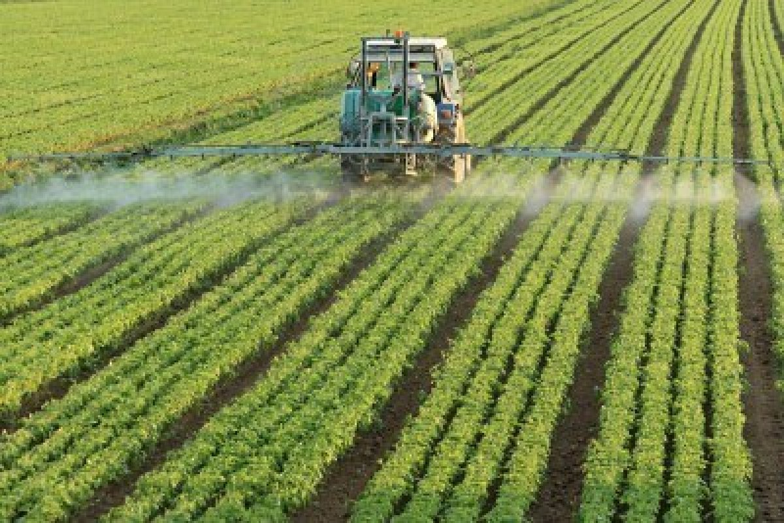

Projects past
Merger of two large companies
Active ingredients
Separable modules
Biology testing
Formulation
Logistics
Chemistry
Query and Reporting
Fiefdoms

Slide 11
Common architecture
Groups from both previous companies
Away Weekend
Each had good ideas
Decision: None, or really both
Effect:
Division of the development team
No common understanding
Poor user experience
Double the effort in maintenance
Learning:
Every project needs a single point of technical leadership

Slide 12
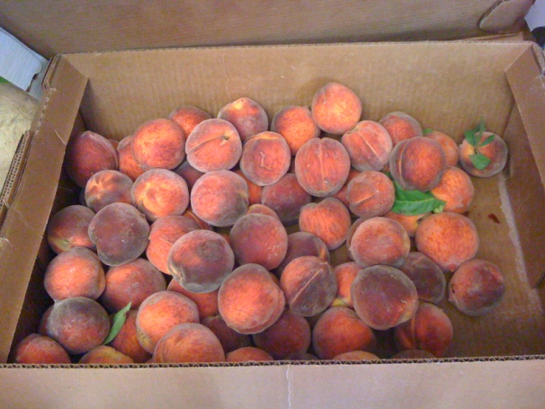
One mans answer to everyone's problems
Another merger project
Harmonise residue testing & results
Led by experts in the UK
For use at centres across the globe
Clever technical solutions
Communication
Insufficient involvement of the other groups
Lack of buy in
Effect
Project suspended, 20 man years of effort wasted
Learning:
All stakeholder locations need real input

Slide 13
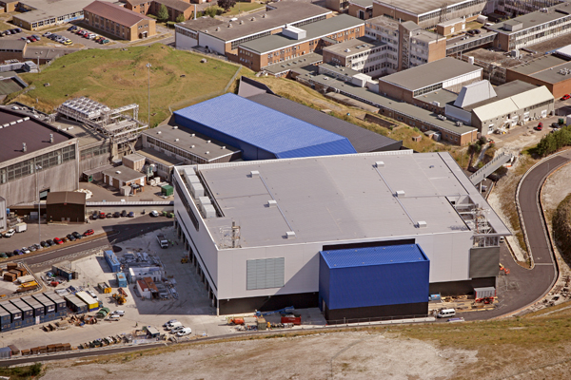
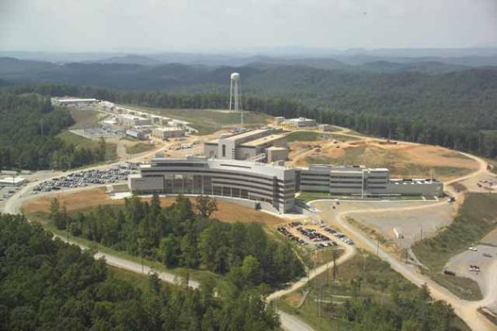
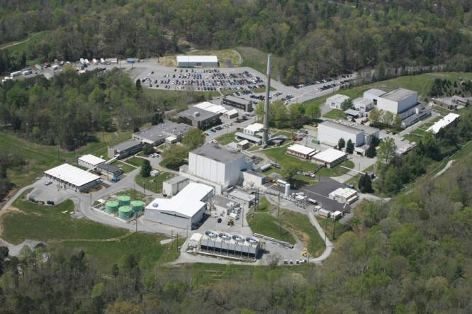
ISIS - SNS & HFIR collaboration

Slide 14
Project Organisation
ISIS
SNS/HIFR
Users
Scientific Steering Committee
Development Team
Users
Scientific Steering Committee
Development Team
Project Management Board

Slide 15
Communication
Face to face meetings
PM 2-3yr
Developer workshops
Developer Transfer
ISIS lead developer transferred to US
Easy communication channels
Developer email list
Skype
Phone
Screen sharing
Video conferencing

Slide 16


Continuous Integration Environment
Deploy to
Download site
Mantid Project Wiki
GitHub Repository
Automated System test
Build + unit test
-Linux (RHE & Ubuntu)
-Mac OSX
-Windows 32
-Windows 64
trac Issue
tracking
system
Developers

Slide 17
Automated Testing
Unit Testing
Test individual components
5,222 tests
Fast – just a few minutes
Run on all platforms on commit
Rapid feedback to developers
Automated System Tests
Test complete workflows
Compare numerical results with stored examples
59 tests
Slow – minutes to hours
Run on all platforms daily
Feedback to all developers

Slide 18
Manual Testing
Developer Testing
Each change tested
Unscripted testing
Whole development team
3-6 days effort
Tests on one of a few environments
Communication and knowledge sharing
Each developer tests other peoples work
Usability and general usage tests
Each environment tested
Low coverage
User Testing
Very high quality feedback & future requirements
Instrument scientists
Only once well tested & interactive development
Generate confidence
Must be well managed

Slide 19
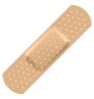
Releases
Development
Automated release
Daily
Full Release
Quarterly
Patch
2-4 weeks after a full release
Full release notes
Wide announcement
If system tests pass
Useful
Not stable
Full manual testing
Targeted testing
Low risk
Targeted improvements & fixes
Code review
Stable
Stable

Slide 20
Conclusion
Software is mission critical to modern neutron facilities
High performance
Reliable
Leading edge
Responsive to change
Maintainable
Well documented
To get these a project needs
Vision
Resource
Stability
Scientific and Technical Leadership
Talented developers

Slide 21
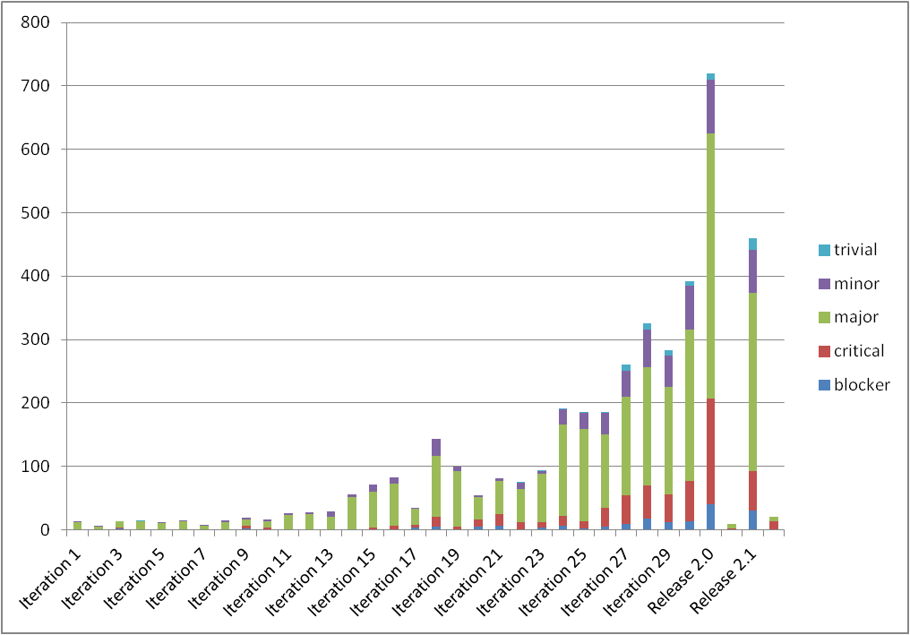

Conclusion
A facility alone can provide these needs
Although many are not used to devoting their resources toward software developments.
Working together between facilities multiplies the benefits over working alone.

